Slide 1
Machine Learning Final Project
Sherwin, Kim, Decker, Camha
August 1, 2019

Slide 2
Intro: Do what your heart desires or do what is easy.
Nothing is easy with Machine Learning.
Using the tools outlined, we will create a Flask app that will take in a .csv file containing specific HR metrics about current comployees from the user and generate a prediction of how likely the employee is to leave the company (not considering the difference in how they left).
Tools to be Utilized:
Python pandas
Python numpy
Python matplotlib
Sklearn linear regression
Sklearn random forest
Flask

Slide 3
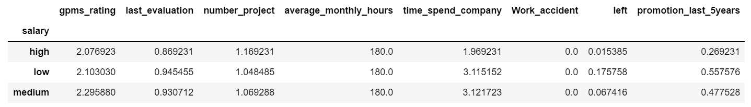
Data Cleansing and Learning Galore
Using Python Pandas with Jupyter Notebook, we learn the data structure and what the data is about. We also prepare the data for Machine Learning.

Slide 4
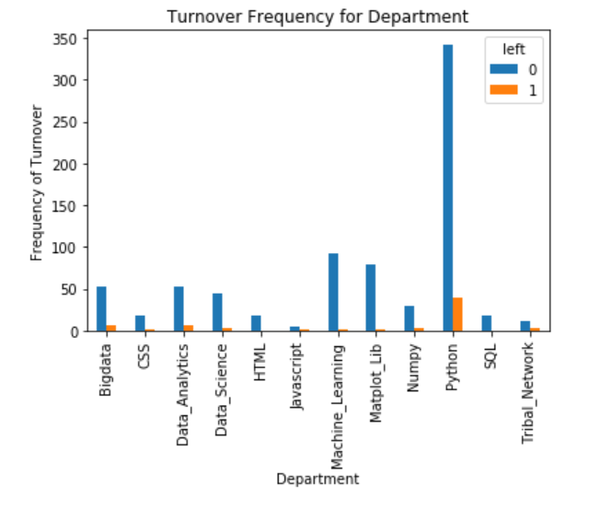
Get a sense of the numbers across these two classes. Employees that are active and employees that left.

Slide 5
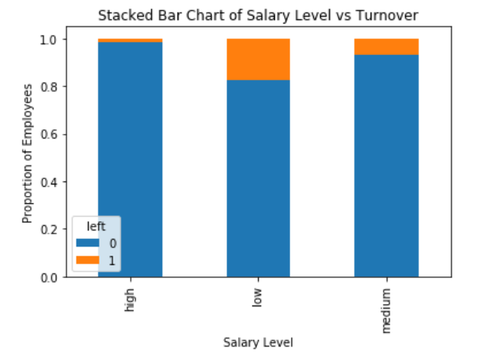
Salary level is a good indicator the outcome of the employees leaving

Slide 6
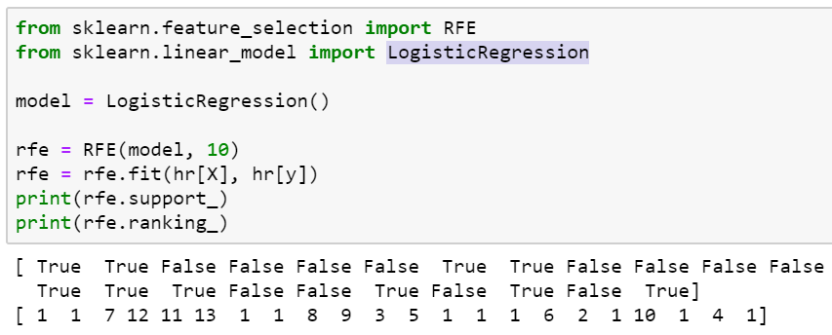
Oh No! Machine Learning Model Selection
Using LogisticRegression to choose the top 10 importance of factors.

Slide 7
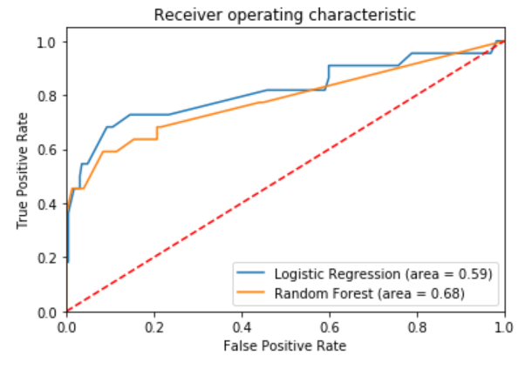
Train 2 models that are Logistic Regression and Random Forest to compare

Slide 8
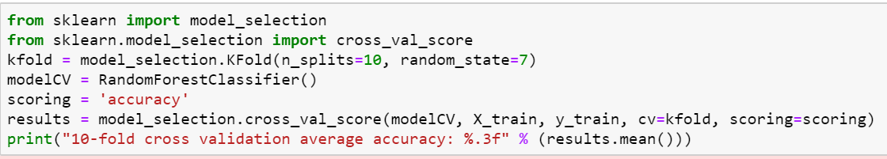
Use 10-fold Cross-Validation to validate the Random Forest model

Slide 9
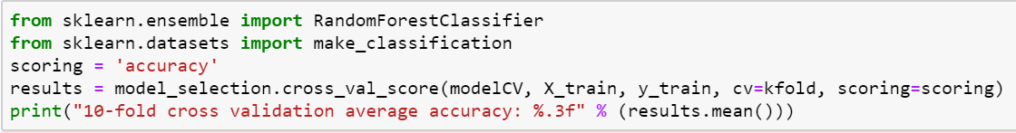
One more: Use another 10-fold Cross-Validation to validate the Random Forest model

Slide 10
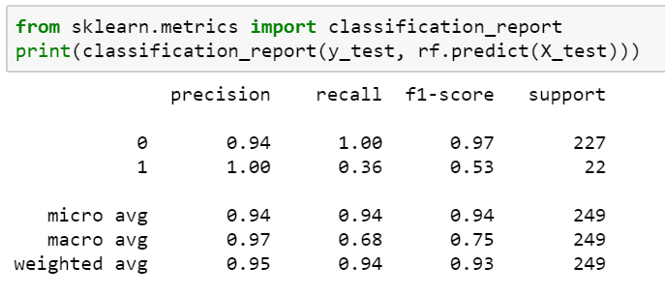
F1 Score is a an overall measure of a model’s accuracy that combines precision and recall

Slide 11
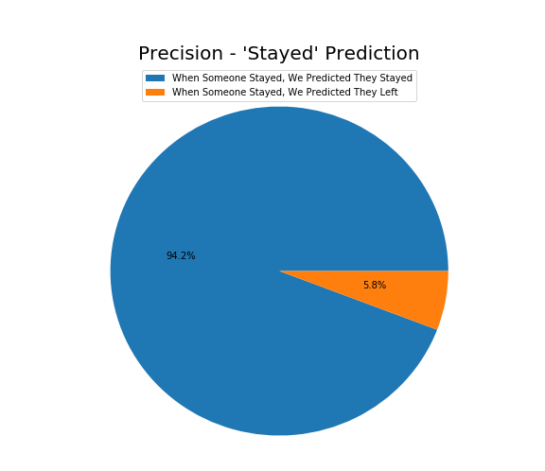
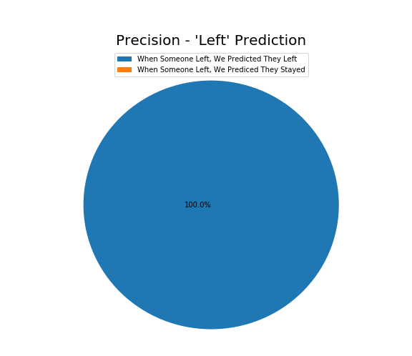
Finally: Prediction, prediction, prediction…..
Precision: Measure false positive

Slide 12
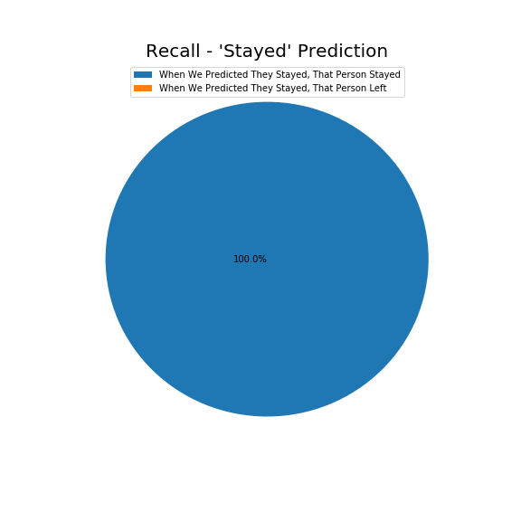
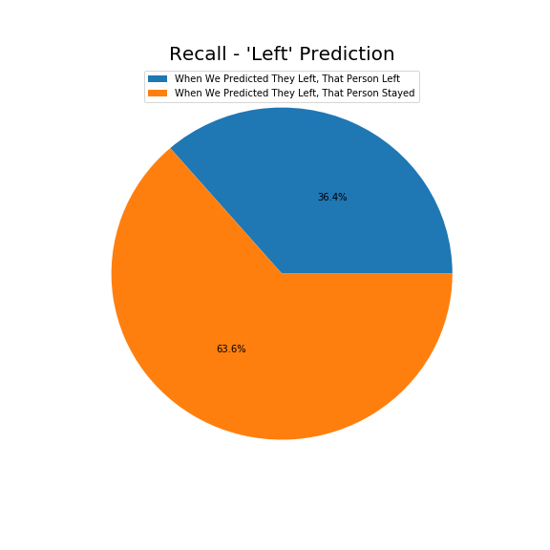
More Finally: Prediction, prediction, prediction…..
Recall: Measure false negative.

Slide 13
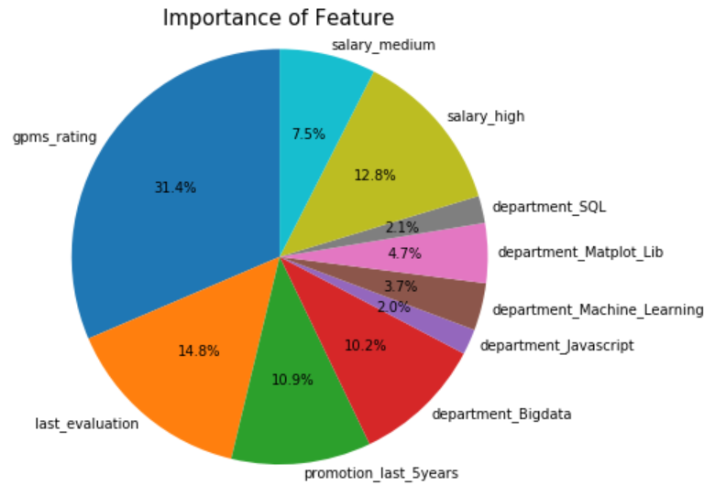
Random Forest evaluates the importance of features on an artificial classification task

Slide 14
“Humans should be worried about the threat posed by Artificial Intelligence”
- Bill Gates
Don’t worry. Revolution is in progress.

Slide 15
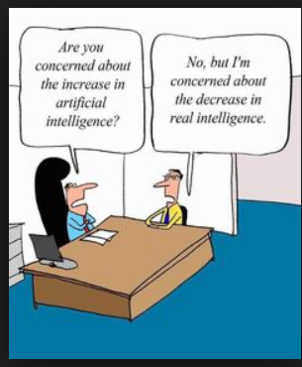

Slide 16
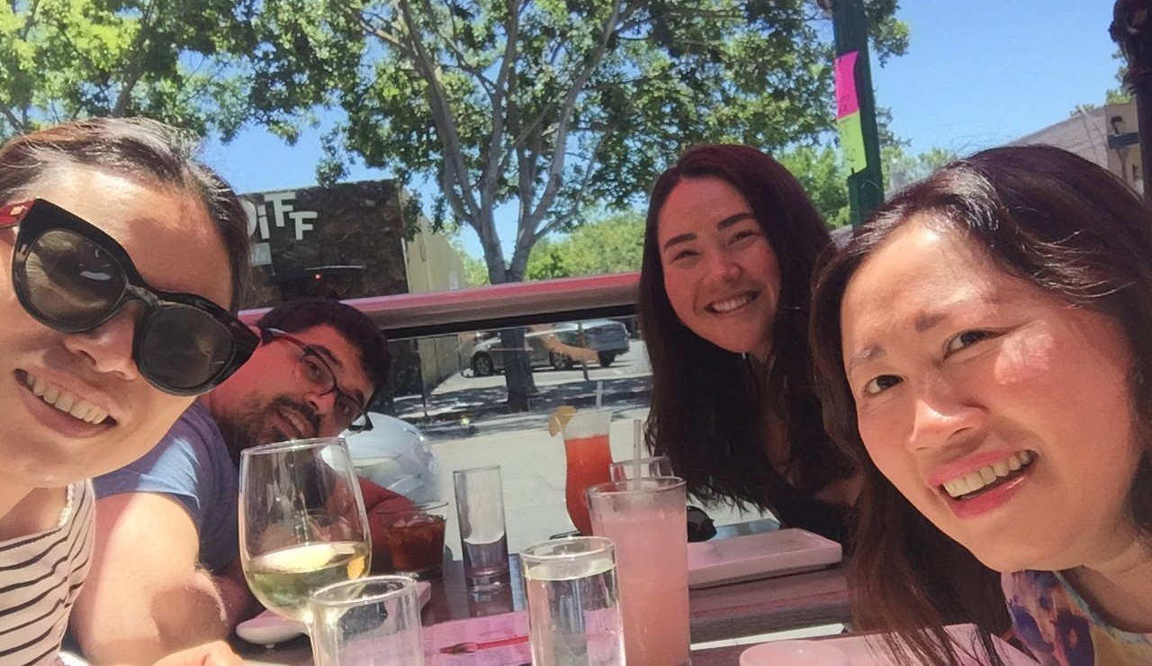
This is the most important takeaway that everyone has to remember. We have fun. Wine is important when you do homework.

Slide 17

Thanks!
Contact us:
Project Too Much Homework
123 Wine Street
Brewery City, Winery 12345
no_reply@projecttoomuchhomework.com
www.projecttoomuchhomework.com

